Slide 1
Lattice Slides

Slide 2
Lattice Overview
For each point in the lattice
For a given N (number of controller iterations)
Compute the next point on the lattice based on the number of LEC classifications from 0 to N
So the lattice can determine if a sequence of LEC detections and misdetections is guaranteed safe
Conservatism
The resulting lattice is a 2-d array of points where each point has a set of transitions to other points on the lattice
The transitions are based on the number of LEC detections and misdetections

Slide 3
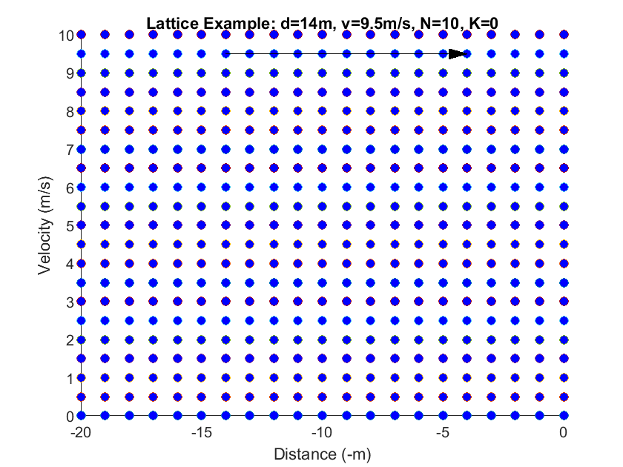
Constructing Lattice Transitions

Slide 4
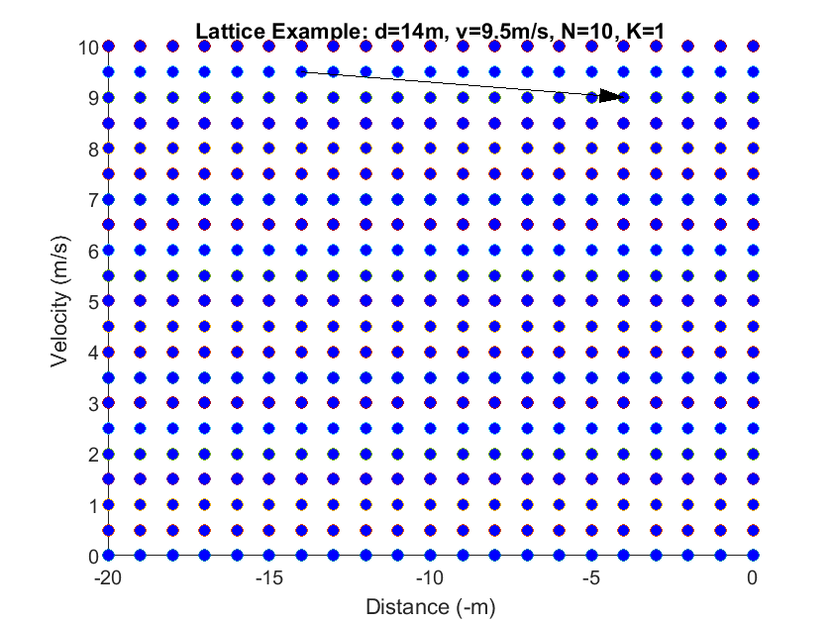
Constructing Lattice Transitions

Slide 5
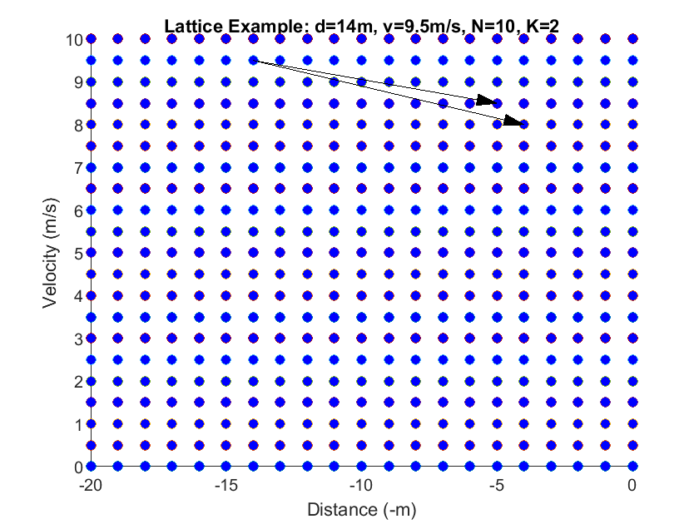
Constructing Lattice Transitions

Slide 6
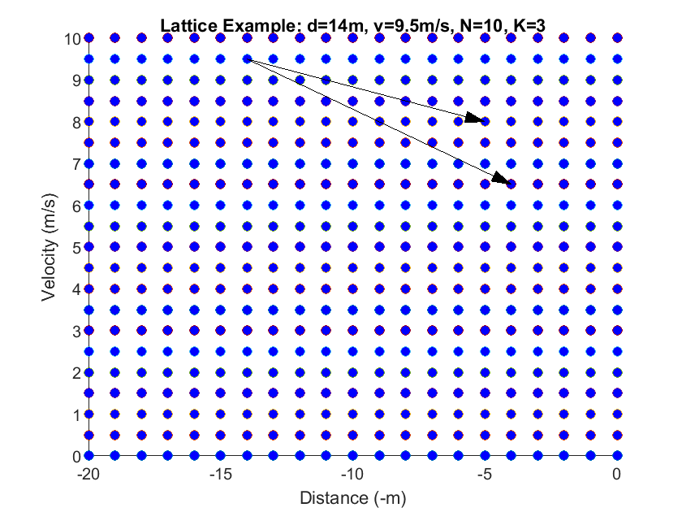
Constructing Lattice Transitions
Notes:
This, when combined with the slide below, doesn’t make sense
Need to check this out

Slide 7
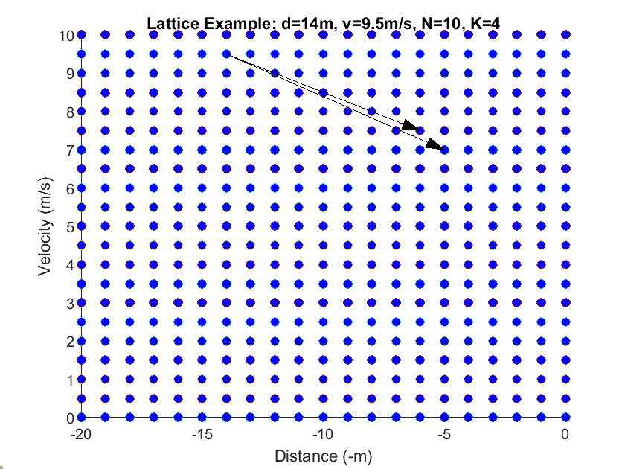
Constructing Lattice Transitions

Slide 8
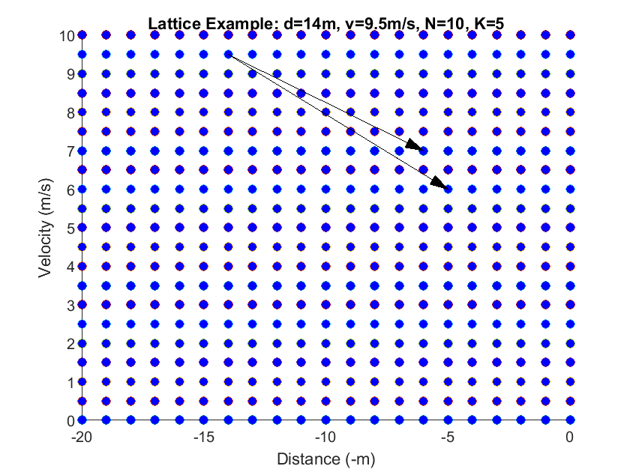
Constructing Lattice Transitions

Slide 9
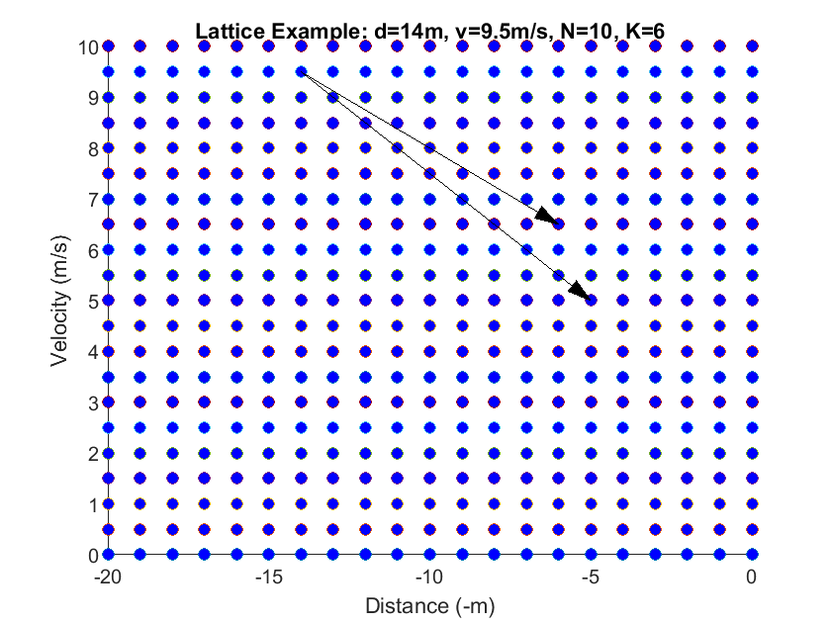
Constructing Lattice Transitions

Slide 10
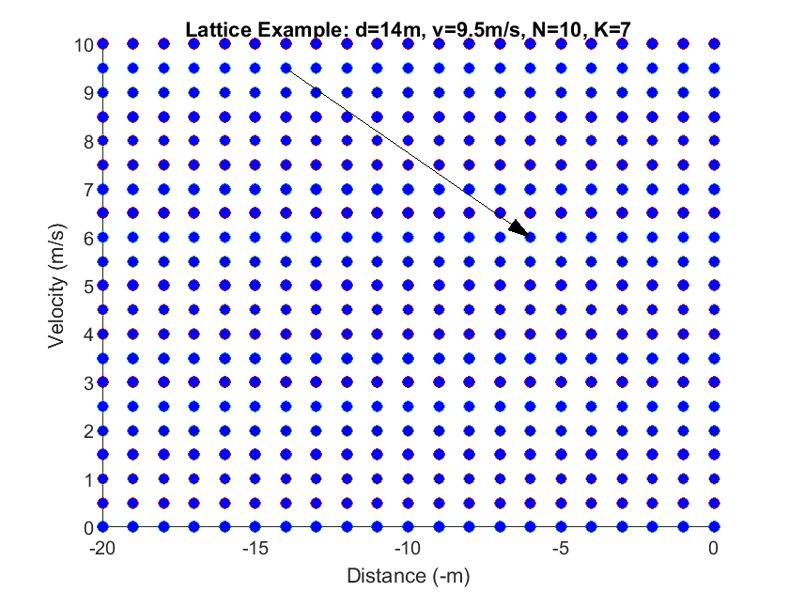
Constructing Lattice Transitions

Slide 11
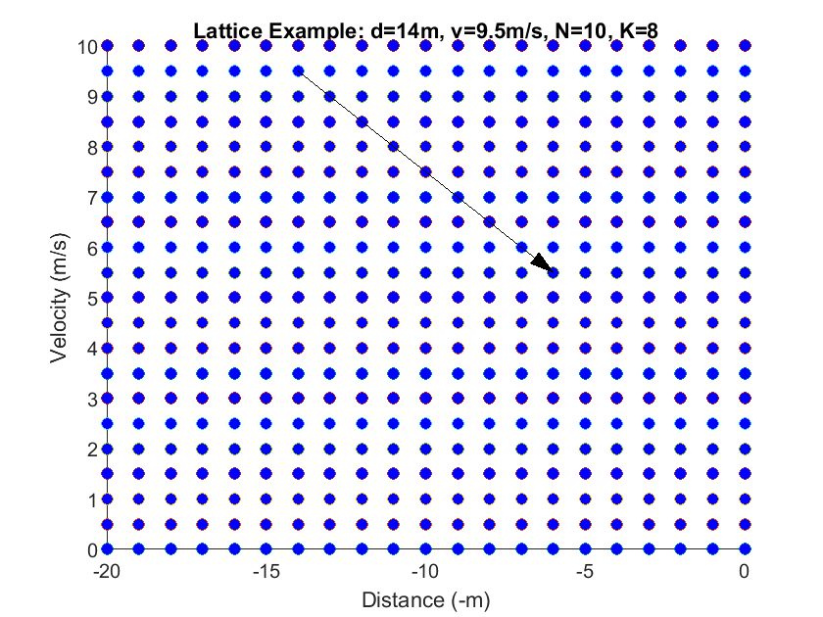
Constructing Lattice Transitions

Slide 12
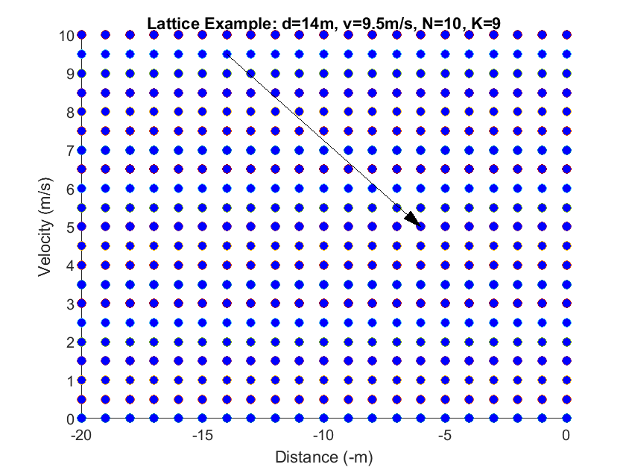
Constructing Lattice Transitions

Slide 13
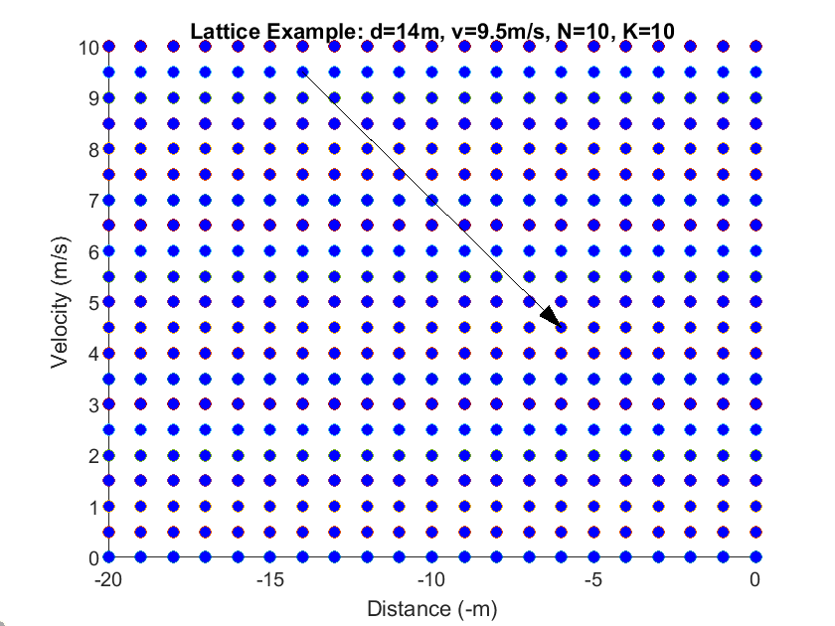
Constructing Lattice Transitions

Slide 14
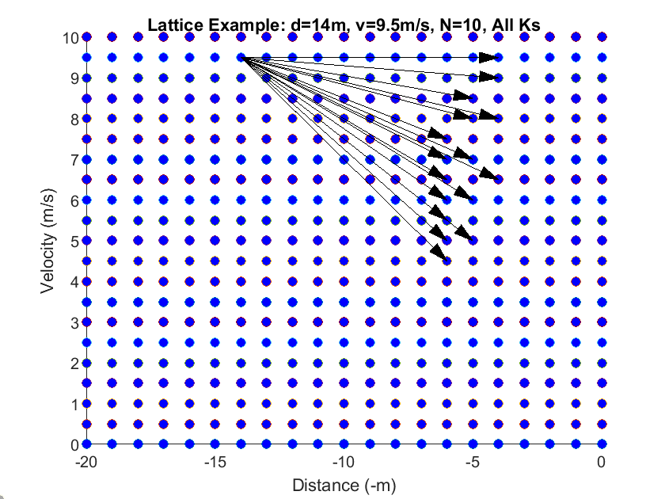
Constructing Lattice Transitions

Slide 15

Visuals

Slide 16
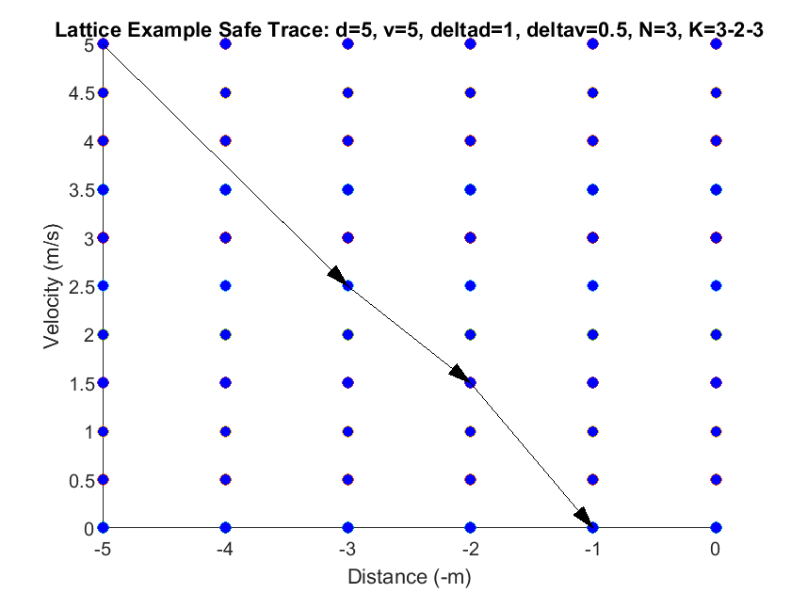
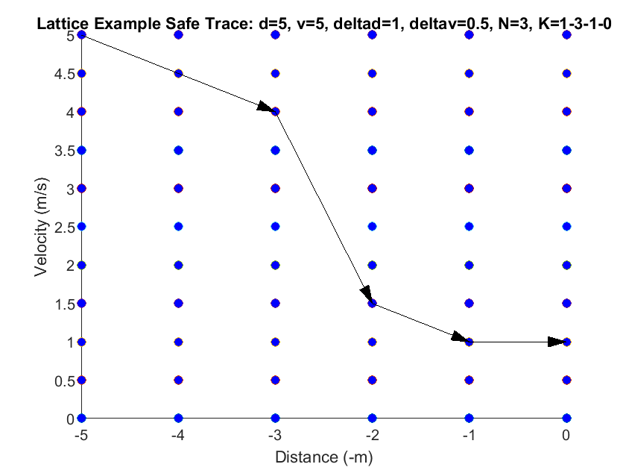
Safe/Unsafe Traces

Slide 17
Lattice and LEC Model
The lattice is composed with a perception LEC model
The LEC model produces sequences of detections/misdetections to run through the lattice
This results in a Markov Decision Process (MDP)
MDP: markov chain with non-deterministic transitions
There are tools for analyzing MDPs
Eg PRISM

Slide 18
I/O Composition
Car and AEBS Controller
Lattice
LEC Model
Perception
Discretization and abstraction
Ex. Fixed true positive rate
Markov Decision Process
The LEC model outputs serve as the inputs to the lattice
PRISM
Lower bound on true probability of crashing

Slide 19
Lattice Safety Argument
Why is a safe lattice trace guaranteed to be safe on the real system?
Trace: A sequence of LEC detections and misdetections
The lattice only rounds distances down and velocities up
It computes the weakest possible braking action at each step
The controller braking power is monotonic w.r.t. distance and velocity
Distance up means braking power down
Velocity up means braking power up
Weakest braking action computed using rounded down distance and rounded up velocity
The lattice uses non-determinism to resolve the detection ordering problem
So all in all, the lattice under approximates distance, overapproximates velocity and underapproximates braking power

Slide 20
Full Safety Argument
The lattice defines a set of guaranteed safe traces
The LEC model provides a faithful (or conservative) representation of our perception
Unclear what exactly conservatism even means in this case
Intuitively, a conservative LEC model should give more misdetections than the actual perception
So if a sequence of LEC detections/misdetections is safe on our lattice, then it is safe on the real system AND the LEC is at least as likely to generate a trace with at least that number of detections as the real perception

Slide 21
TODO
Convert the lattice (with precomputed K and N transitions) into a PRISM model
Add the LEC model to the PRISM model
Figure out the LEC conservatism aspect
How to motivate fixed true positive rate model?

